Slide 1
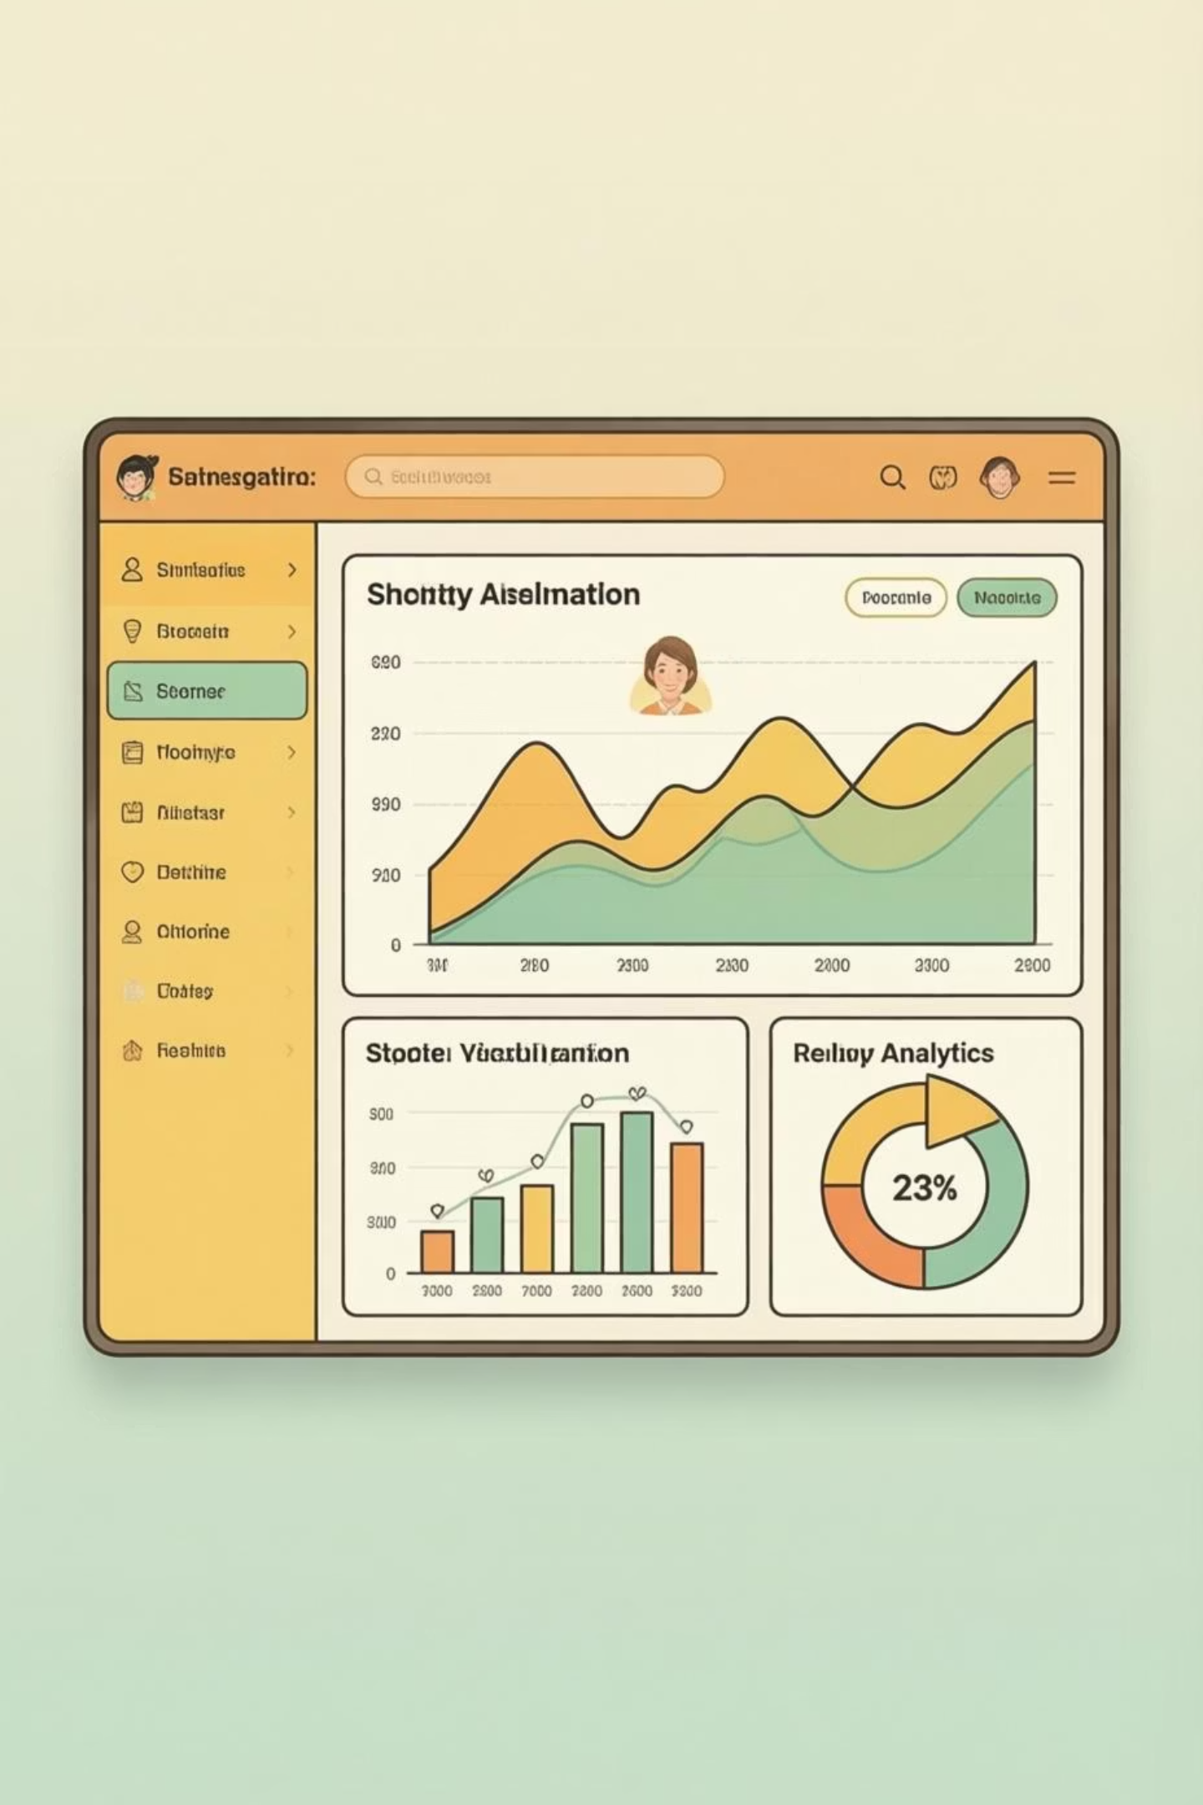
Customer Shopping Behavior Analysis
Uncovering insights from 3,900 purchases to guide strategic business decisions

Slide 2
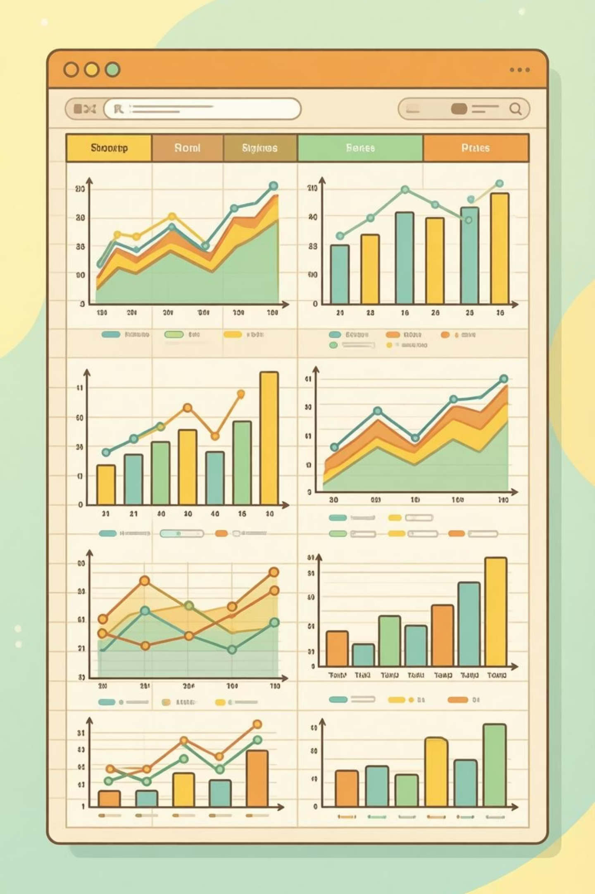
DATASET OVERVIEW
The Foundation
3,900
18
4
Total Purchases
Data Points
Categories
Features per customer
Product segments
Transactions analyzed
50
Locations
Geographic spread

Slide 3
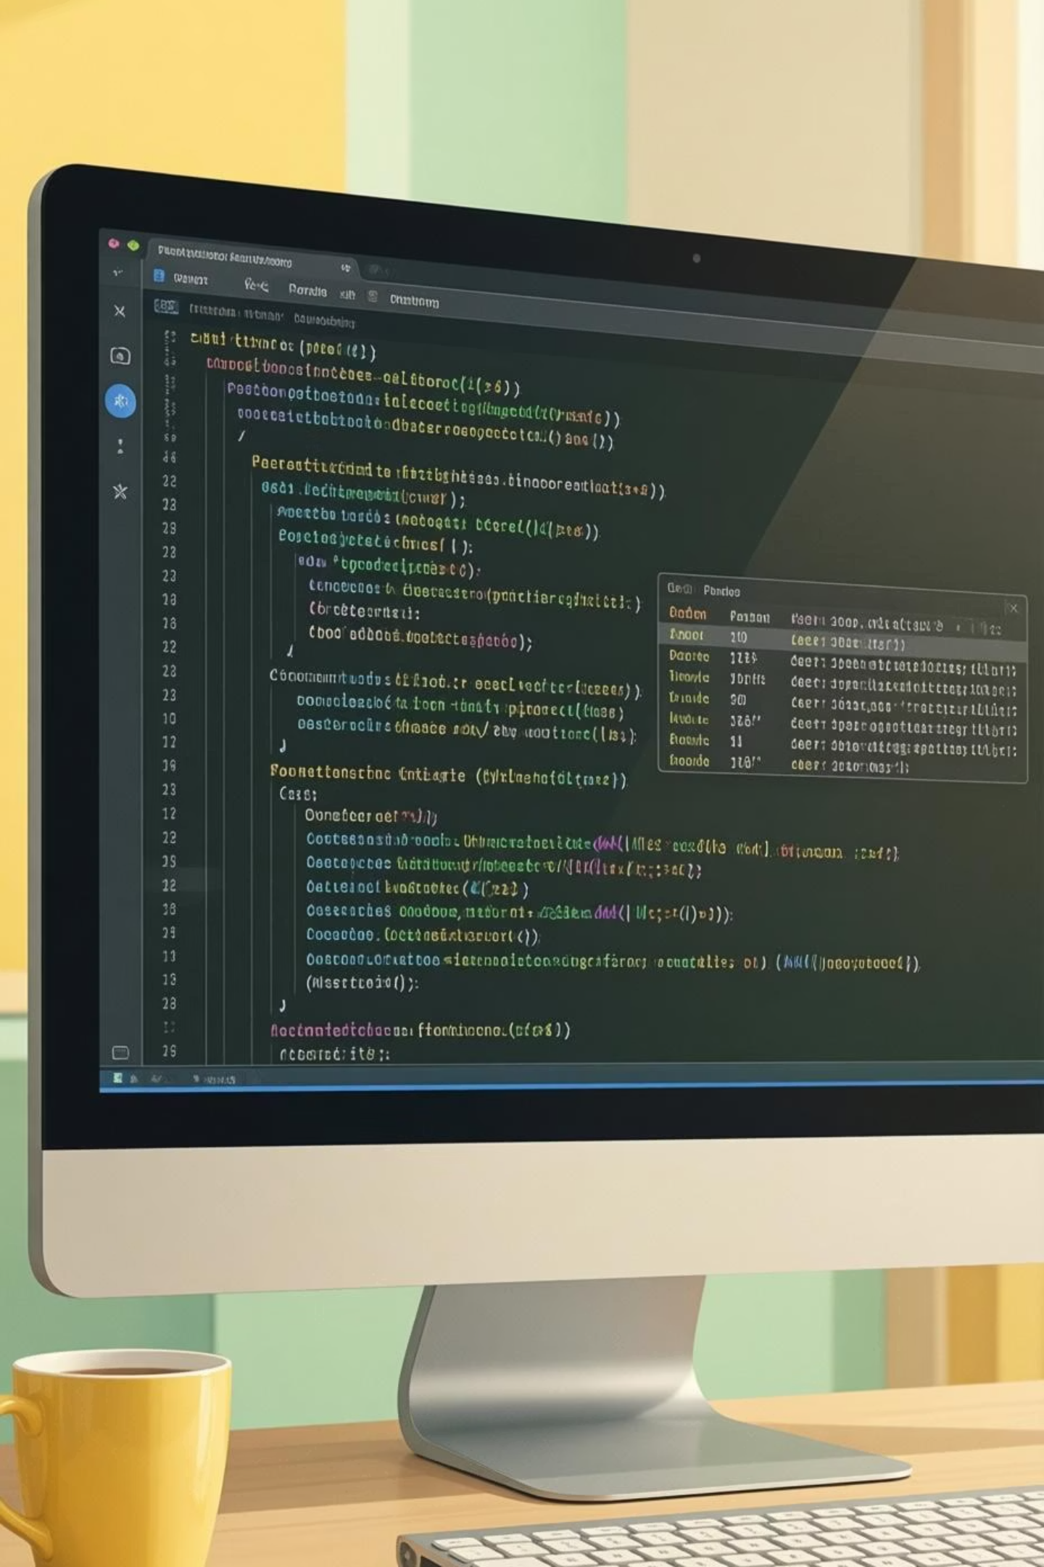
PHASE 1
Data Preparation in Python
01
Data Loading & Exploration
Imported dataset, checked structure with pandas
02
Missing Data Handling
Imputed 37 missing Review Ratings using median
03
Feature Engineering
Created age groups and purchase frequency metrics
04
Database Integration
Connected to PostgreSQL for SQL analysis

Slide 4
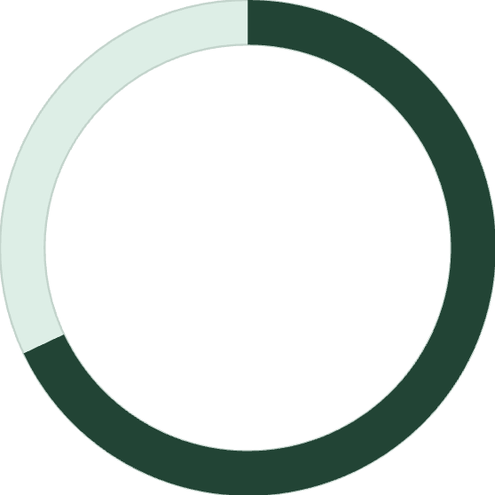
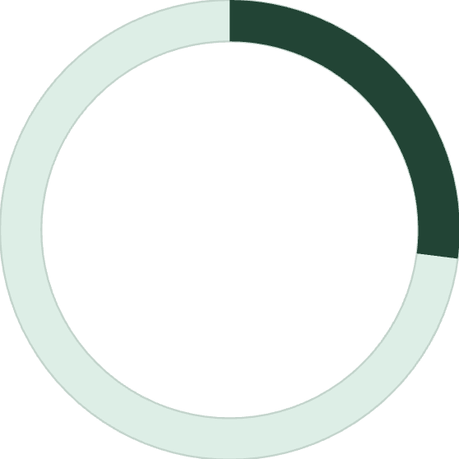
KEY METRICS
Customer Profile Snapshot
Average Customer
Age: 44 years old
Spend: $59.76 per purchase
68%
Rating: 3.75 stars
Previous purchases: 25
Male Customers
Dominant demographic
27%
Subscribers
Active subscription rate

Slide 5
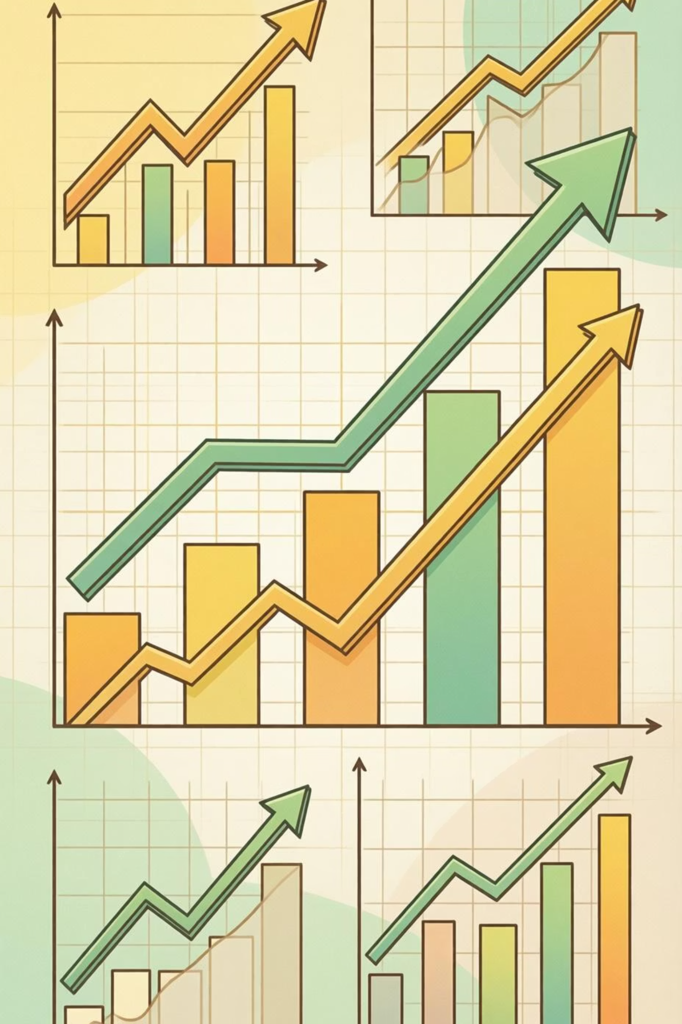
PHASE 2
SQL Analysis: Revenue Insights
Gender Revenue Gap
Shipping Preferences
Male: $157,890
Express: $60.48 avg
Female: $75,191
Standard: $58.46 avg
Males generate 2x more revenue
Premium shipping = higher spend
Discount Impact
839 customers used discounts but spent above average
Strategic discount opportunities

Slide 6




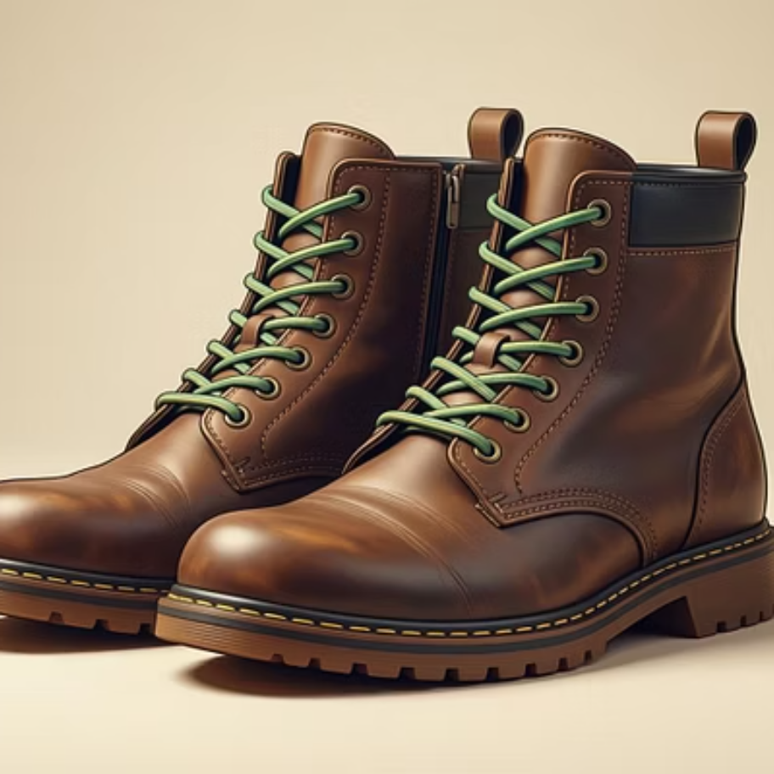
Top Performing Products
Highest Rated Items
Most Discount-Dependent
3.9
3.8
Hat - 50%
Gloves
Sandals
Sneakers - 49.7%
Coat - 49.1%
3.8
Sweater - 48.2%
Pants - 47.4%
Boots

Slide 7



Customer Segmentation
New Customers
1
83 customers (2%)
Returning
2
701 customers (18%)
Loyal Base
3
3,116 customers (80%)
Strong loyalty foundation with opportunity to convert returning customers

Slide 8


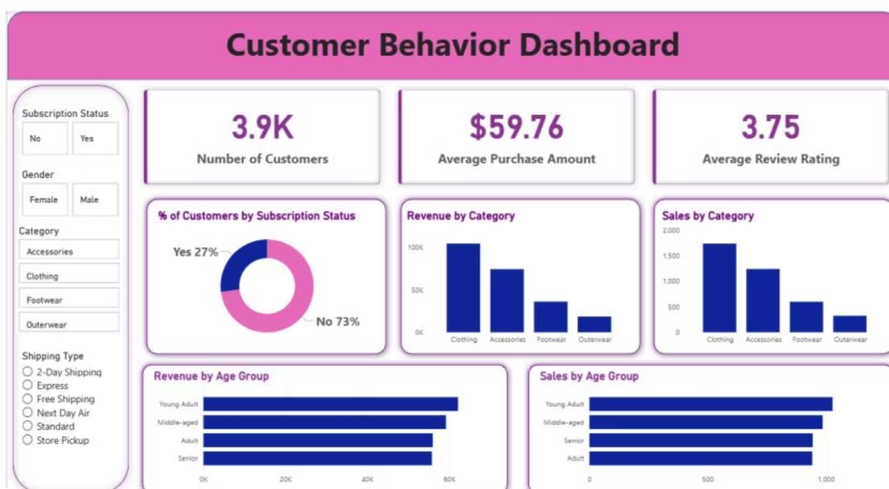
DASHBOARD
Power BI Visualization
Clothing Leads
$100K revenue, 1,800 sales
Young Adults Drive Sales
Highest revenue at $62K
Strong Satisfaction
3.75 average rating

Slide 9
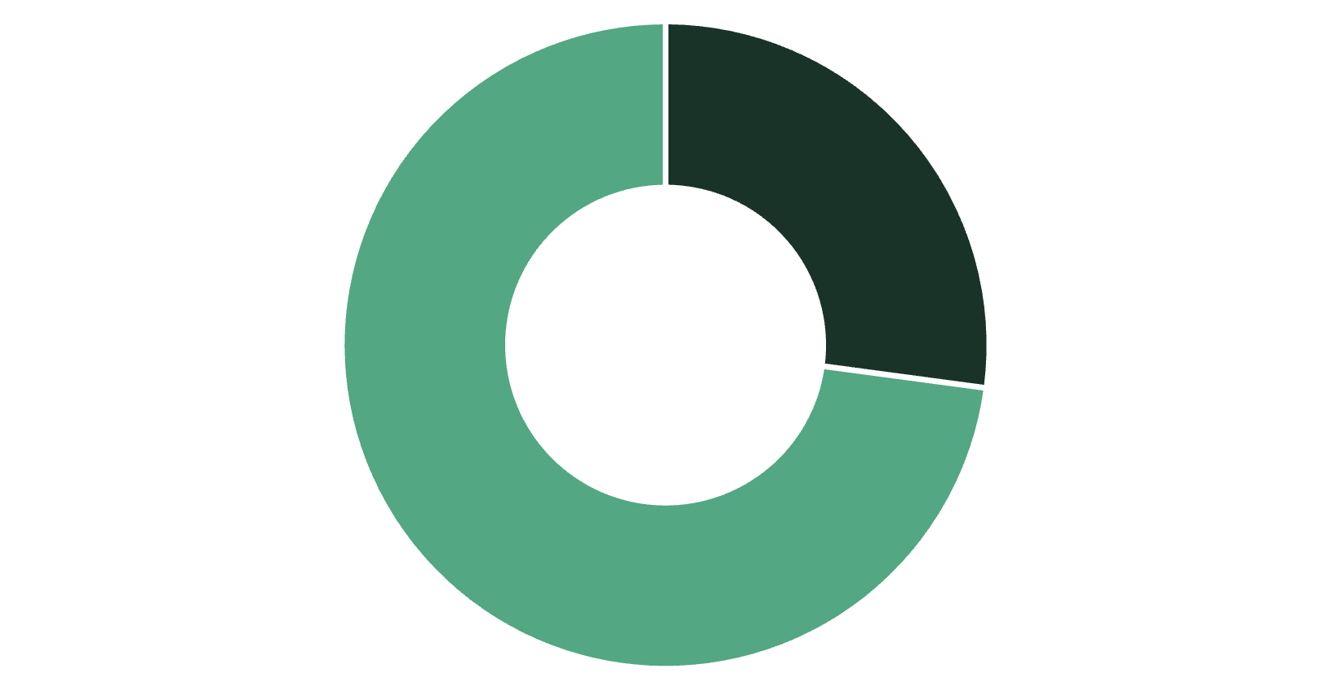
Subscription Analysis
Key Finding
Subscribers and non-subscribers show similar average spend ($59.49 vs $59.87)
958 repeat buyers with 5+ purchases are subscribers
Opportunity to convert 2,518 repeat non-subscribers
Subscribers
Non-Subscribers

Slide 10
ACTION PLAN
Strategic Recommendations
Boost Subscriptions
1
Promote exclusive benefits to convert 2,518 repeat non-subscribers
Loyalty Programs
2
Reward repeat buyers to accelerate movement into loyal segment
Review Discount Policy
3
Balance sales boosts with margin control for discount-dependent products
Product Positioning
4
Highlight top-rated items (Gloves, Sandals, Boots) in marketing campaigns
Targeted Marketing
5
Focus on young adults and express-shipping users for maximum ROI

